Slide 1
PROJECT TITLE
PIP104 University Project-II
Review-1
Batch Number:
Roll Number | Student Name
20201ISE076 | Angeline Stanley
20201ISE082 | Sakshi Oswal
20201ISE0048 | Grantha Kushalappa
20201ISE0071 | Berlin Gangamma
Under the Supervision of,
Mrs. Pushpalatha
Associate Professor
School of Computer Science & Engineering
Presidency University

Slide 2
Introduction
This is a system/portal for gathering on the spot information during road accidents. This information includes photos of the site, interviews with eyewitnesses, information on injuries and fatalities, reason for accident, speed ,road condition on relative basis, etc. All this data can go into a central database. This responsibility for collecting the data could be given either to police, transport authority, ambulance or even ordinary citizens who volunteer for the same. In the same system, there is also a provision to submit/exchange insurance numbers/ details in order to settle the dispute if any arising out of the accident.

Slide 3
Literature Review
The existing fraudster detection methodsal ways consider people who violate normal behaviour patterns as fraudsters. However, fraudsters can evade these monitors by camouflage, by adding normal behaviours so that they look ‘‘normal.’’ Our focus is to spot healthcare insurance patient fraudsters in the presence of camouflage. Although camouflage may hinder fraudster detection to some extent, we find that camouflage behaviours always sustain in a short period when the fraudster is conducting fraud.
The claim is the first step toward being compensated for medical expenses, lost wages, or other damages resulting from the accident. The insurance company will then open an investigation of the claim and victims may be asked to submit the accident report or independent medical examination by a doctor.

Slide 4
Literature Review
Machine Learning Approaches to Traffic Accident Analysis and Hotspot Prediction
Traffic accidents are one of the most important concerns of the world, since they result in numerous casualties, injuries, and fatalities each year, as well as significant economic losses. There are many factors that are responsible for causing road accidents. If these factors can be better understood and predicted, it might be possible to take measures to mitigate the damages and its severity. The purpose of this work is to identify these factors using accident data from 2016 to 2019 from the district of Setúbal, Portugal. This work aims at developing models that can select a set of influential factors that may be used to classify the severity of an accident, supporting an analysis on the accident data. In addition, this study also proposes a predictive model for future road accidents based on past data.

Slide 5
Literature Review
The research article titled "On The Spot (Real time) Accident Information & Insurance Dispute Resolution," published in the Turkish Journal of Computer and Mathematics Education in 2021, addresses the need for a system or portal to collect real-time information during road accidents.
The research article discusses the need for a system to collect real-time information during road accidents. This system would gather data like accident scene photos, eyewitness interviews, injury and fatality details, accident causes, and road conditions. The information would be stored in a central database. Additionally, the system allows for the exchange of insurance information to resolve accident-related disputes. The objective is to improve emergency services and contribute to injury prevention by facilitating better decision-making through data integration. The article mentions the use of specific technologies like Net Beans, JDBC, and J2EE in implementing this system.

Slide 6
Literature Review
Using Real-Time Road Traffic Data to Evaluate Congestion
Discusses the use of real-time road traffic data to assess and alleviate congestion, with a focus on urban areas. It highlights the importance of providing accurate information to travelers to encourage alternative modes of transport and manage congestion. The use of road-user pricing and the role of vehicle data, particularly from public transport buses, are explored. The data from buses can be repurposed for broader traffic network analysis, providing valuable insights into traffic behaviour under different conditions. This analysis helps in offering more reliable and accurate real-time information to travelers to reduce congestion.

Slide 7
Proposed Method
The centralized server or database is maintained to store all the information about the accident as the doctor can also upload their information about the accident it will store in the server. This duty regarding gathering the information could be offered either to police, transport experts, rescue vehicles or even customary subjects who volunteer for the equivalent. Then the user will request the doctor and police for the report to claim the insurance.
A system used for pre-generating insurance claims, accident data associated with a vehicle accident involving a driver may be collected. The accident data may be analyzed, and a likely severity of the vehicle accident may be determined based upon the analysis of the accident data. An estimated insurance claim may be generated based upon the determined likely severity of the vehicle accident, and transmitted, via wireless communication, from one or more remote servers to a mobile device associated with the driver to facilitate presenting all, or a portion of, the estimated insurance claim to the driver or the insured.

Slide 8
Objectives
The objectives of the "On-Spot Accident Information and Insurance Dispute Resolution" system can be summarized as follows:
Efficient Accident Reporting: To establish an efficient system for reporting accidents by collecting on-the-spot information, including accident site photos, eyewitness accounts, injury details, and accident causes.
Streamlined Medical Reporting: To streamline the reporting of accident-related medical information, including documenting client movements upon impact, tracking symptoms, treatments, and medical reviews.
Accurate Matching of Casualty Records: To accurately match individual accident casualty reports by collecting and updating data from both police and hospital records, along with vehicle and location-based information.
Simplified Insurance Claims Process: To simplify the insurance claims process for accident compensation by facilitating the investigation of claims and ensuring that accident reports and medical examinations are efficiently submitted and processed.
Timely Emergency Services: To provide timely emergency services, encouraging prompt reporting and investigation of accidents, ultimately contributing to injury prevention.
These objectives aim to improve the overall process of accident reporting, medical information collection, insurance claims, and emergency services, with the ultimate goal of reducing delays, ensuring quick responses, and enhancing the accuracy of accident-related data.

Slide 9
Methodology
The methodology involves collecting accident data from various sources, including eyewitnesses, hospitals, and police departments. This data includes accident site photos, injury details, and accident causes. Medical reports are updated, and casualty reports are matched to victim records. The system also helps with insurance claims. The goal is to improve the timeliness of accident reporting and injury prevention, with potential future enhancements in prediction techniques.
Accident Data Collection
Accident Medical Reports
Individual Accident Casualty Report Matching
Insurance Claim for Accident Compensation
Software Tools
The next slide shows the considerations used to develop the framework from developing the testing methodologies.

Slide 10
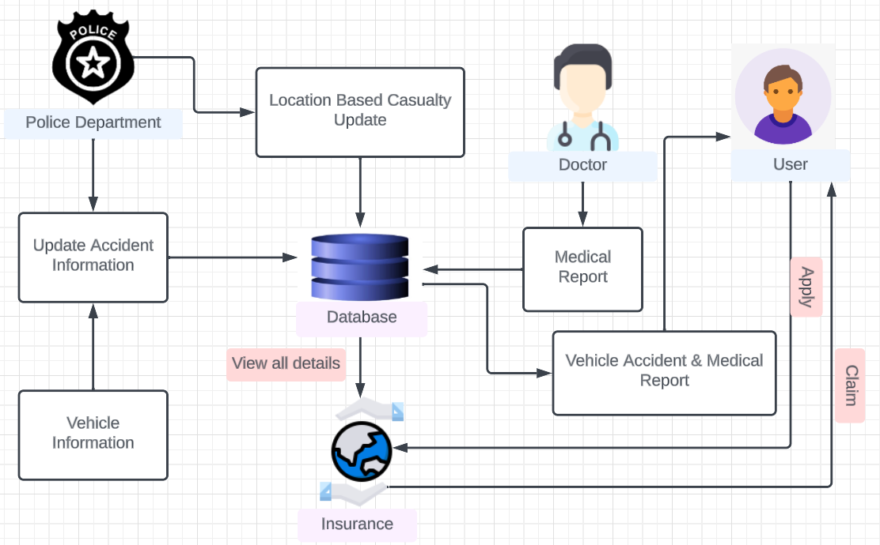
Methodology

Slide 11
Timeline of Project

Slide 12
Expected Outcomes
Improved Accident Data Collection: The system would enhance the quality and quantity of accident data collected, leading to better analysis and understanding of the causes and trends related to road accidents.
Faster Response and Emergency Services: Real-time data collection would help emergency services respond more effectively to accidents by providing them with immediate information on the scene's condition, including the number of injuries and fatalities.
Enhanced Safety Measures: The data collected can be used to identify high-risk areas and implement safety measures, such as road improvements, increased policing, or better signage.
Faster Claims Processing: The provision to submit/exchange insurance details would expedite the claims process, reducing disputes and delays in compensation for accident victims.
Accurate Accident Investigation: The system would provide valuable evidence for accident investigations, helping law enforcement agencies establish the cause of accidents and determine fault.
Behavioral Changes: The knowledge that data is being collected and shared may encourage safer driving behavior among motorists, leading to a reduction in accidents.
Citizen Involvement: Involving ordinary citizens as volunteers can foster a sense of community responsibility and engagement in road safety.
Centralized Database: A centralized database ensures that all relevant agencies have access to the same information, reducing redundancy and improving collaboration among different stakeholders.
Trend Analysis and Prediction: Over time, the collected data can be used for trend analysis, which can inform road safety policies and predict accident hotspots.
Public Awareness: The existence of such a system can raise awareness about the importance of road safety, leading to more responsible driving and reduced accidents.
Legal Accountability: Accurate data and witness interviews can help in establishing legal accountability, facilitating fair and just resolution of disputes.
Feedback Loop for Improvements: The data can be used as a feedback loop for authorities to continually improve road infrastructure and safety measures based on real-world accident scenarios.

Slide 13
Conclusion
It is concluded that the system is to provide emergency service to get the accident information and reach in time.
Concludes that the system enhances the timeliness of accident reporting, encourages prompt investigation, and contributes to injury prevention.
Stresses that the application contains essential details for summarizing accident reports.
In essence, the implementation of such a system not only promotes transparency and accountability but also encourages a collaborative effort among different parties involved in accident response and resolution

Slide 14
References
www.researchgate.net
webarchive.nationalarchives.gov.uk
https://www.ijana.in/papers/59.pdf
https://www.govinfo.gov/content/pkg/GPO-CRPT-99hrpt1016/pdf/GPO-CRPT-99hrpt1016.pdf
https://turcomat.org/index.php/turkbilmat/article/view/4677

Slide 15
Thank You

